Slide 1

Chester School Sport Partnership
Claire Smedley & Elizabeth Newstead

Slide 2

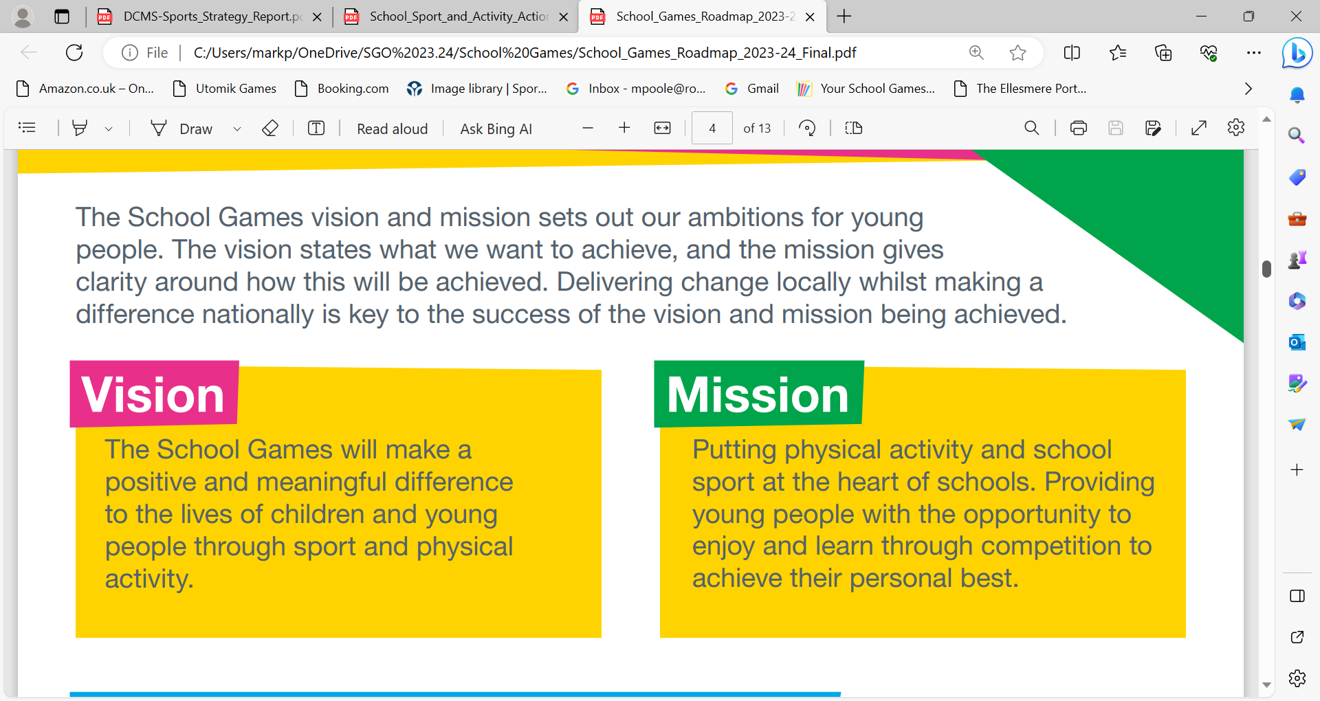
School Games

Slide 3



School Games National Priorities
Tackling Inequalities
Youth Engagement
Physical Literacy
Ensuring we reach those who need it the most
Involving young people in creating their offer
Creating positive experiences

Slide 4
Physical Activity within Schools
This presentation will support you to increase physical activity throughout the school day to boost health and academic achievement for your students.
We will look at how schools can:
meet the requirements of the government’s childhood obesity plan
develop your understanding of the evidence and research underpinning active approaches in schools
explore solutions to boost wellbeing and achievement by building in active minutes of physical activity into the whole school day and influencing active minutes beyond the school day.

Slide 5
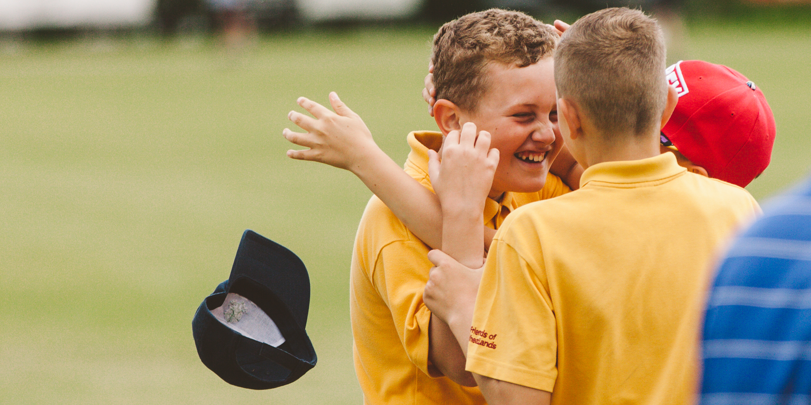
A ‘win:win’ scenario
Schools want their pupils to be happier, healthier and more successful learners
BUT…
At the moment, they are largely judged on their pupils’ short term success as learners

Slide 6
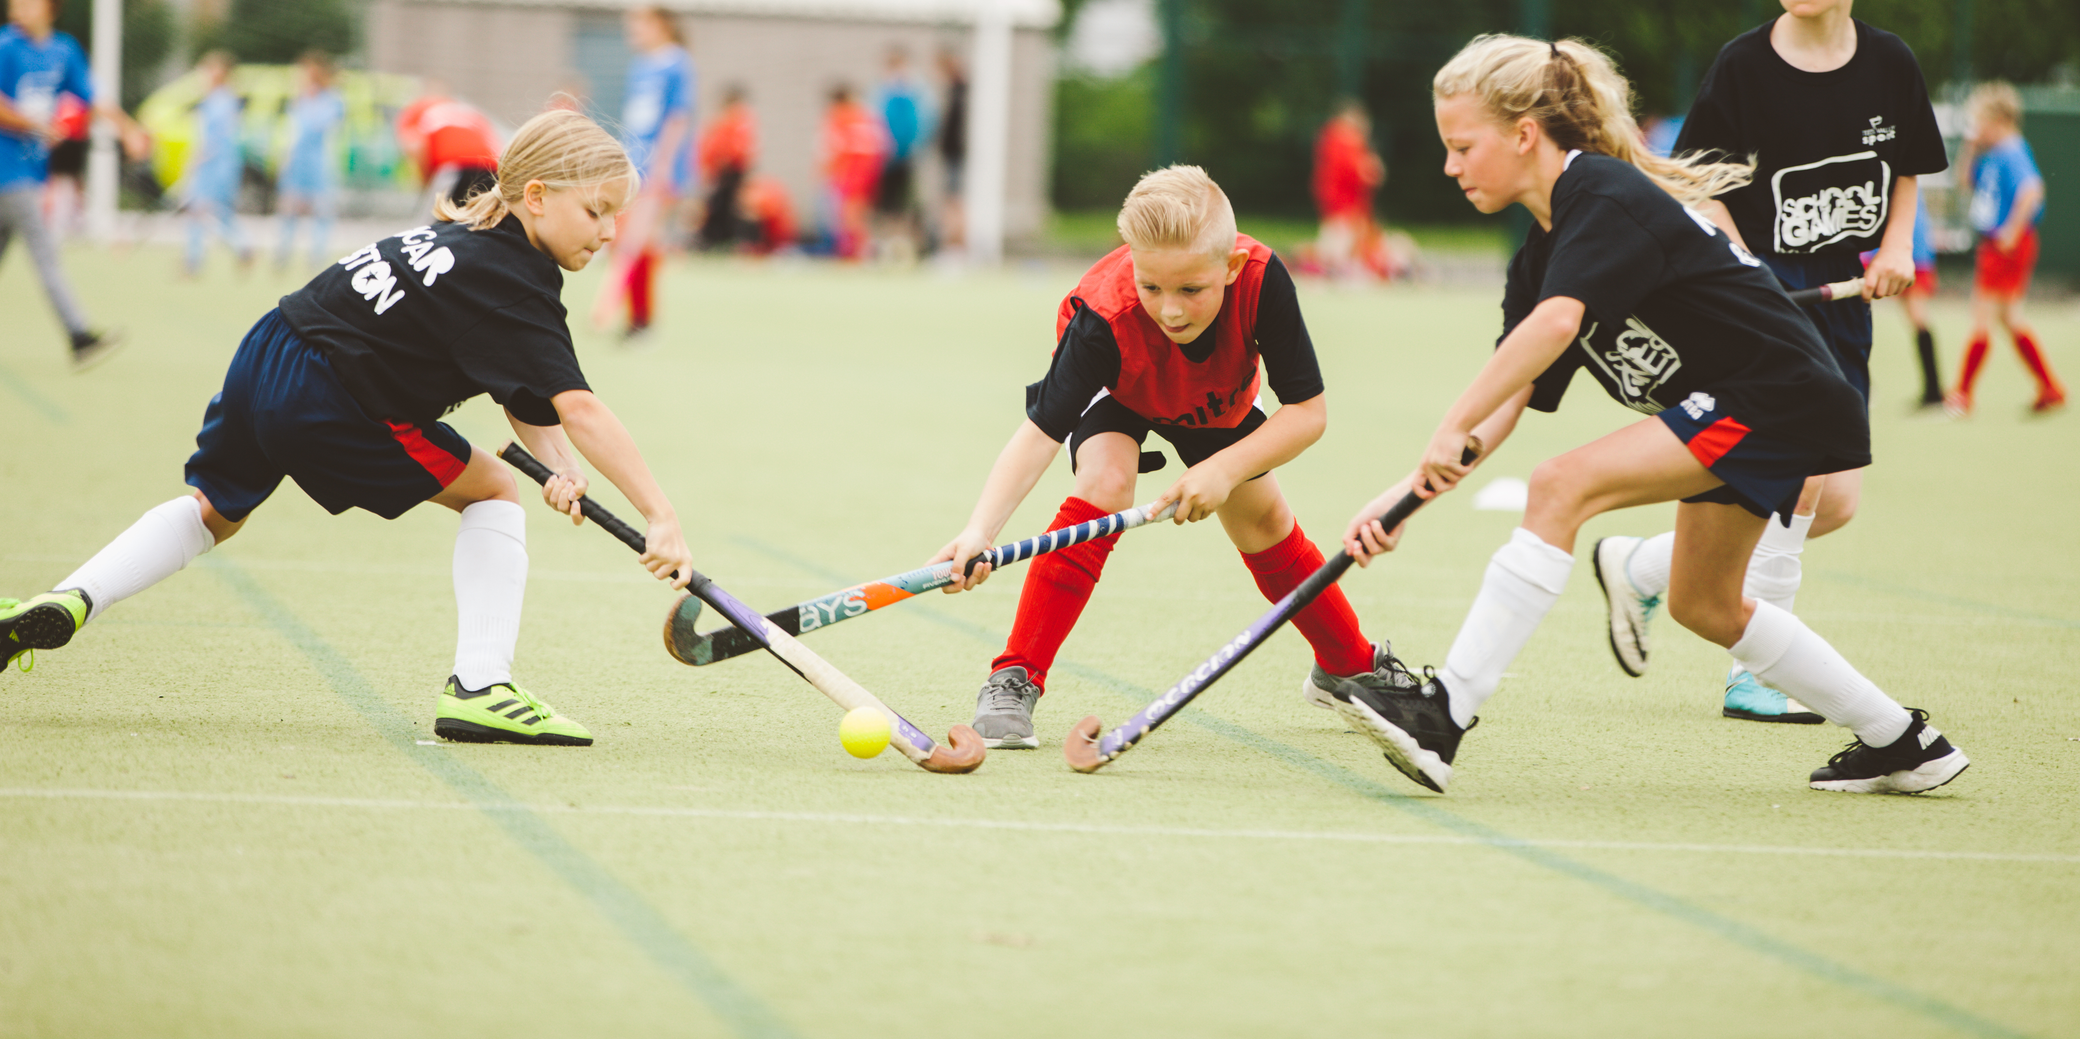
The Challenge
- Nearly a third of children aged 2 to 15 are overweight or obese.
- Younger generations are becoming obese at earlier ages and staying obese for longer.
- Mental Health concerns are sky-rocketing.
- Physical activity participation rates continue to fall short of the Chief Medical Officer’s guidelines for so many.

Slide 7

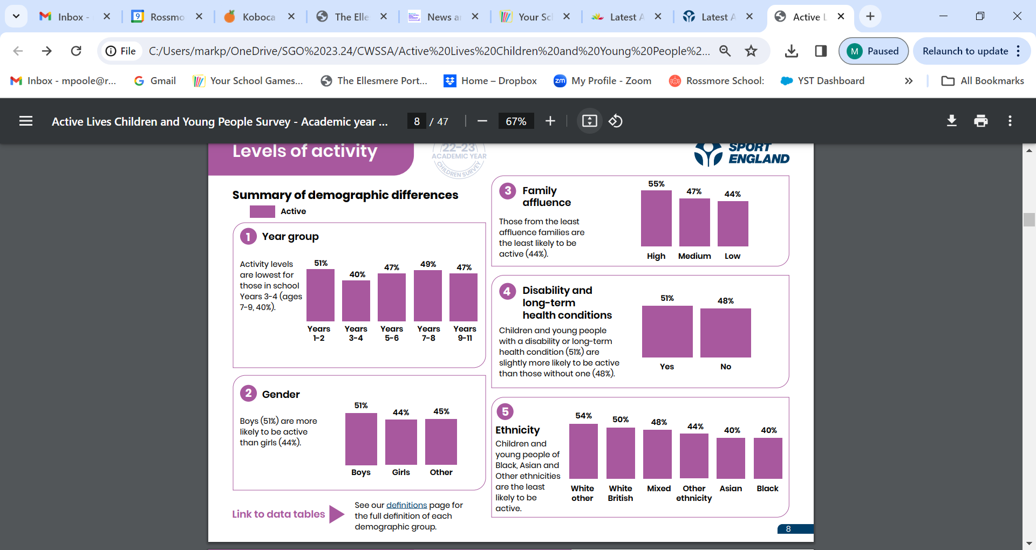
Active Lives Survey 2022-2023.

Slide 8
Active Lives Survey (2022-23)
If we are to hit the government’s target of getting over one million more children active by 2030 (the target in their new Get Active strategy), then there is real work to be done.
The recent Active Lives Children and Young People Survey shows that currently, less than half of children (47.0%) achieve the Chief Medical Officers’ guidelines when it comes to exercise, while nearly a third (30.2%) are doing fewer than 30 minutes of activity a day.
Even starker is that our research shows there are significant inequalities depending on a child’s ethnicity, gender, socio-economic status and age.
Every child and young person has the right to be active and benefit from being active in a safe, positive and trusted environment.
And what is clear is that teachers, schools and early-years settings are crucial in helping make this happen!

Slide 9
Active Lives Survey (2022-23)
Today’s figures show that activity during school hours has increased slightly compared to when we started this survey five years ago, but it’s still the case that children and young people are more likely to do 30+ minutes of activity a day outside of school hours (55%) than during them (43%).
For the future health of our nation, we owe it to our children and young people that they have a positive relationship with movement and experiences of sport and physical activity that are fun, inclusive and help them develop.
We know that children and young people are more likely to thrive when they are happy, healthy, and active – so we need to prioritise children’s health, wellbeing and activity because these are important foundations in children to learn and grow.
The starting point for this is ‘physical literacy’.

Slide 10
Physical Literacy
The Physical Literacy Consensus Statement for England has been developed to facilitate a shared understanding of physical literacy for those working in the sport, education, physical activity, recreation, play, health and youth sectors.
“Every child and young person has the right to be active, to benefit from being active in a safe, positive and trusted environment, and to have an equal chance to achieve their potential,”
“We must ensure children and young people have positive experiences of sport and physical activity that are fun, inclusive and help them develop”
“It must be seen as one of the first steps in our efforts to promote positive experiences and lifelong participation for all children and young people, but particularly for those who face the greatest inequalities”

Slide 11

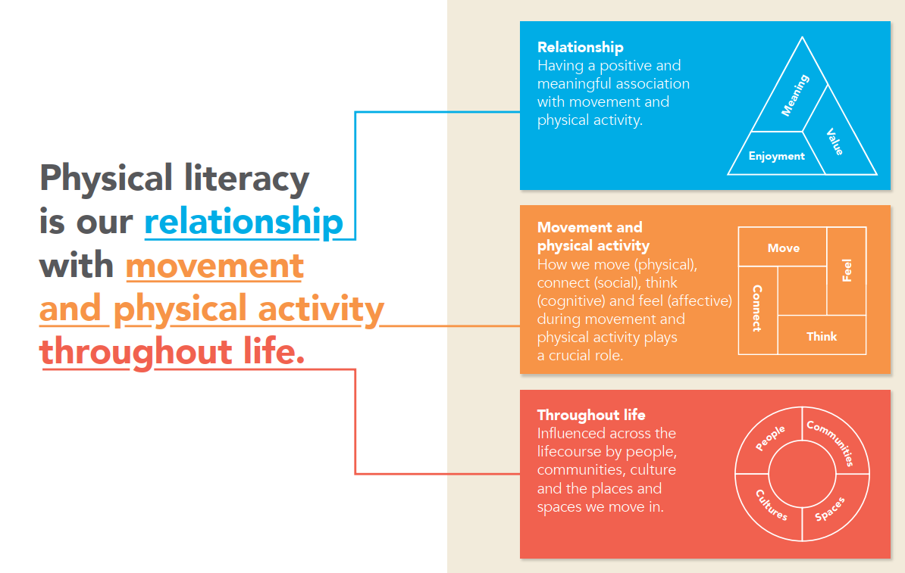

Notes:
Highlight the importance of the ‘relationship’ piece.
Physical Literacy is our relationship with movement and physical activity throughout life.
It shapes and is shaped by how we think, feel, move and connect in and through movement
It is effected by people, community, culture, places, and spaces around us
It impacts on how we value, enjoy and engage with physical activity
It contributes to our health, wellbeing and quality of life
It evolves, changes, ebbs and flows throughout life
It’s personal because no one person’s relationship is the same
It’s why we like and loathe physical activity

Slide 12
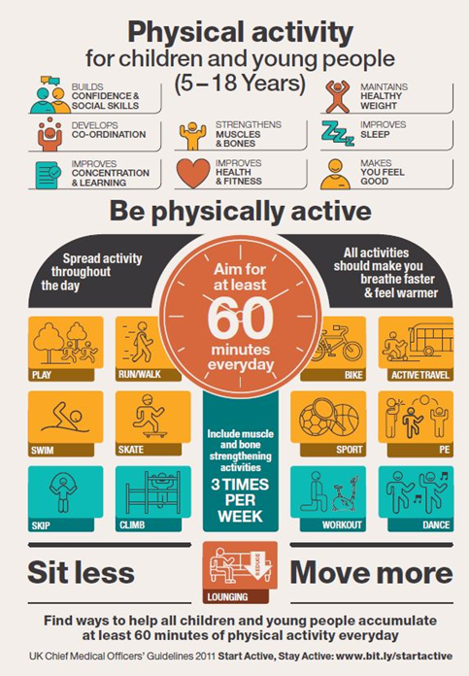
The Role of Schools
Every primary school child should get an average of at least 60 minutes of moderate to vigorous physical activity a day.
At least 30 minutes should be delivered in
school every day.
(Chief Medical Officer’s Guidelines).

Slide 13
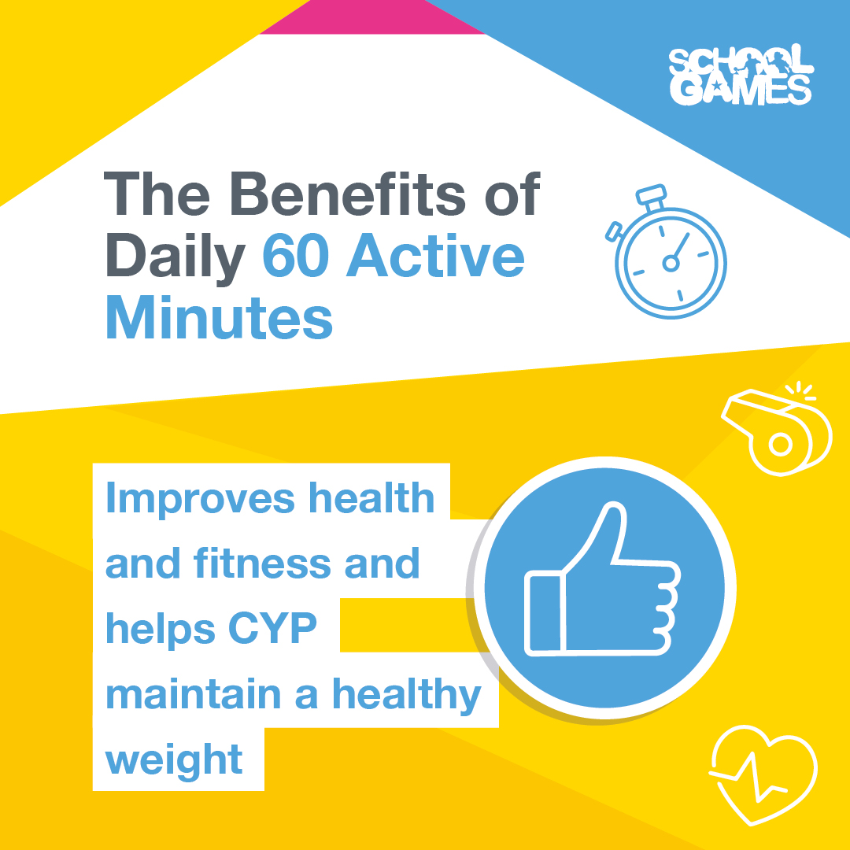
Boosts mood and creates happier young people.
Improves health & fitness and helps to maintain a healthy weight.
Builds confidence and social skills.
Reduces the risk of developing health conditions in adulthood.
Brain functioning improves, leading to better concentration and learning.
Academic results improve.

Slide 14








The Active 30:30 rationale
Activity across the school day
Health & cognitive benefits start to be realised
Active School
Travel
Before School
Classrooms
Break Times
Lunch times
.
After School
Sedentary Behaviour
Light activity
Moderate Activity
Vigorous Activity
Sleep
Sedentary physiology
Exercise physiology
Notes:
This is a start of a journey for schools!
To achieve the ambitions we need to create an active school culture which integrates and embeds movement throughout the school day – there is NOT an ambition to bolt on physical activity or find additional time in the school timetable. This will mean considering and ‘nudging’ children into standing up more (to avoid sitting time) and increasing their activity levels throughout the day (even if it’s light activity). This way we will start to influence the activity patterns of ALL children, and including those with the greatest health needs.
What we know is there are immediate benefits to reducing inactivity to our general health and to a child’s brain function.
It will require schools to think differently about their offer across the whole day so that they can demonstrate it does engage all children in 30 minutes a day

Slide 15
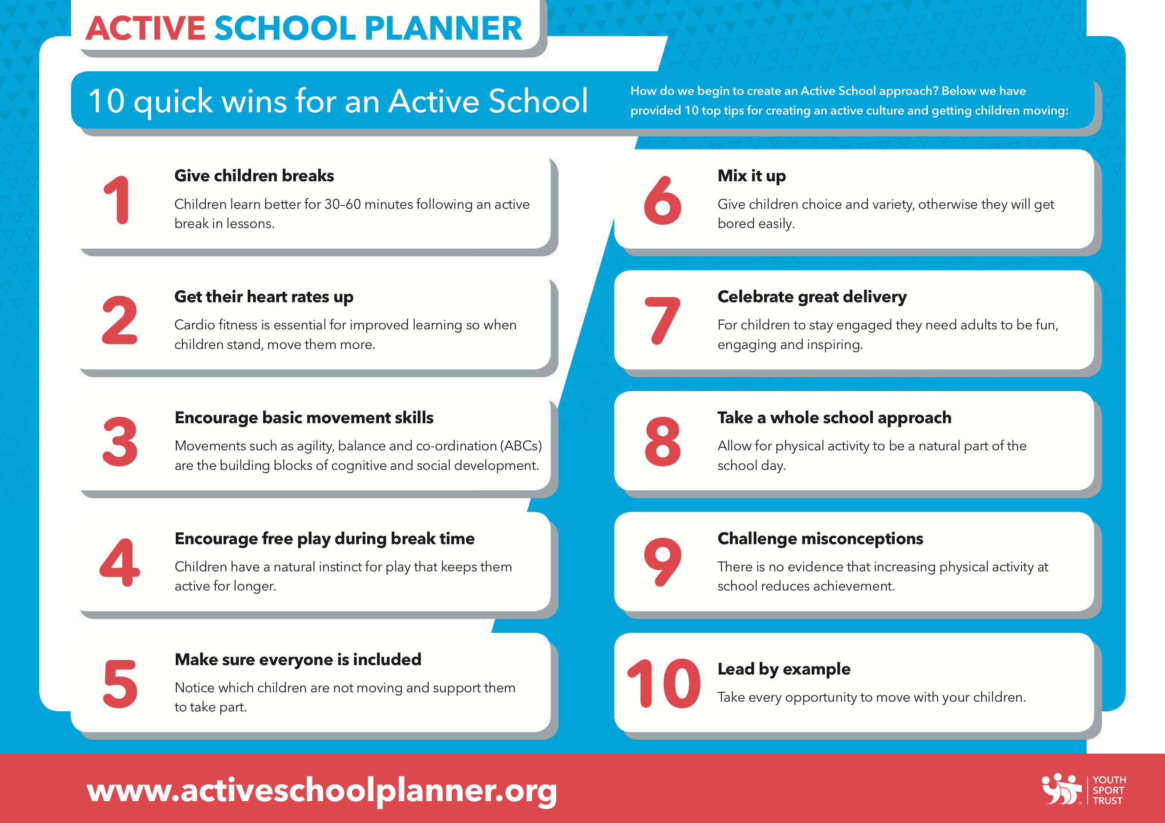

Slide 16
Active Travel
Before School
Active Lessons
Break & Lunch Time
After School
Start 'Walk to School Wednesdays'.
WOW Travel Tracker
Wake & Shake Club
led by pupils.
BBC Super Movers & GO Noodle
Use simple activity breaks to ensure that pupls don't sit down for too long.
Train your lunchtime supervisors or employ a sports coach as a lunchtime supervisor to get pupils active.
Review your after school club offer and encourage all pupils to opt in to a minimum of one club per week.
Organise Bikeability training in your school to encourage more children to ride to school safely.
Introduce activity to your breakfast club.
Change4Life
Provide CPD for staff to encourage and support them to make lessons more active.
Introduce a basic stage area with music for children to practice dance routines.
Set an Active Homework or finish the day with Active Story Time.
Work with volunteers to start a walking bus/scooter club.
Crocodile APP
Set up the playground for a termly challenge and encourage parents to help their children or take part themselves.
Check out resources and websites designed to make learning active.
MOTD/ClassPal
Introduce My Personal Best challenges
Start a Change 4 Life Club after school to engage your least active children.
Get involved in National Walk to School Week.
Awareness Days
Introduce walk & talk tasks in lessons - give pupils a 5 minute break with a discussion topic or questions to answer in pairs.
Invest in a trim trail/field equipment to encourage activity.
Creative Play
Encourage parents & carers to walk home or park their cars further from school to allow a 10 minute walk back to the car..
Start the school day 10 minutes early with physical activity sessions in the classrooms.
Promote & reward 'Park & Stride'. Park 5 mins further away and walk & talk for the rest of the journey.
Introduce Playground Leaders/Buddies to encourage activity.
Work in partnership with local sports clubs and offer use of your facilities in return for them delivering an after school club for pupils.
Consider introducing the daily mile. Parents could be invited to join in.
Check out Premier League Primary Stars website for cross curricular ideas.

Slide 17

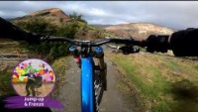

Lets Get Active In Lesson

Slide 18
THANK YOU

